Slide 1

Green Cloud Framework for AI-Aware Virtual Machine Placement and Energy Optimization
An intelligent cloud resource management framework using CloudSim Plus and AI for energy-efficient VM placement, migration and monitoring.
CSA1501-Cloud Computing
Under the guidance of
Done by
Dr MD Boomija
Deepak R (192511008)
Bharath S (192521034)

Slide 2
Abstract
CloudSim-based simulation: Simulates cloud infrastructure using hosts, VMs, and cloudlets without requiring physical cloud hardware.
Resource monitoring: Monitors CPU, RAM, VM utilization, running workloads, and host status during simulation.
Energy analysis: Calculates host power consumption and total energy usage to evaluate the energy efficiency of different cloud configurations.
Resource management: Tracks VM placement and migrations to study how workloads are distributed across physical hosts.
Performance evaluation: Measures SLA violations, cloudlet execution, resource utilization, and migration behavior under different workloads.
Live visualization: Provides a live dashboard with KPI cards, utilization graphs, energy graphs, migration timeline, and host-level details.
Configuration comparison: Allows different numbers of hosts, VMs, and workload sizes to be tested and compared before deploying similar infrastructure in a real environment.

Slide 3
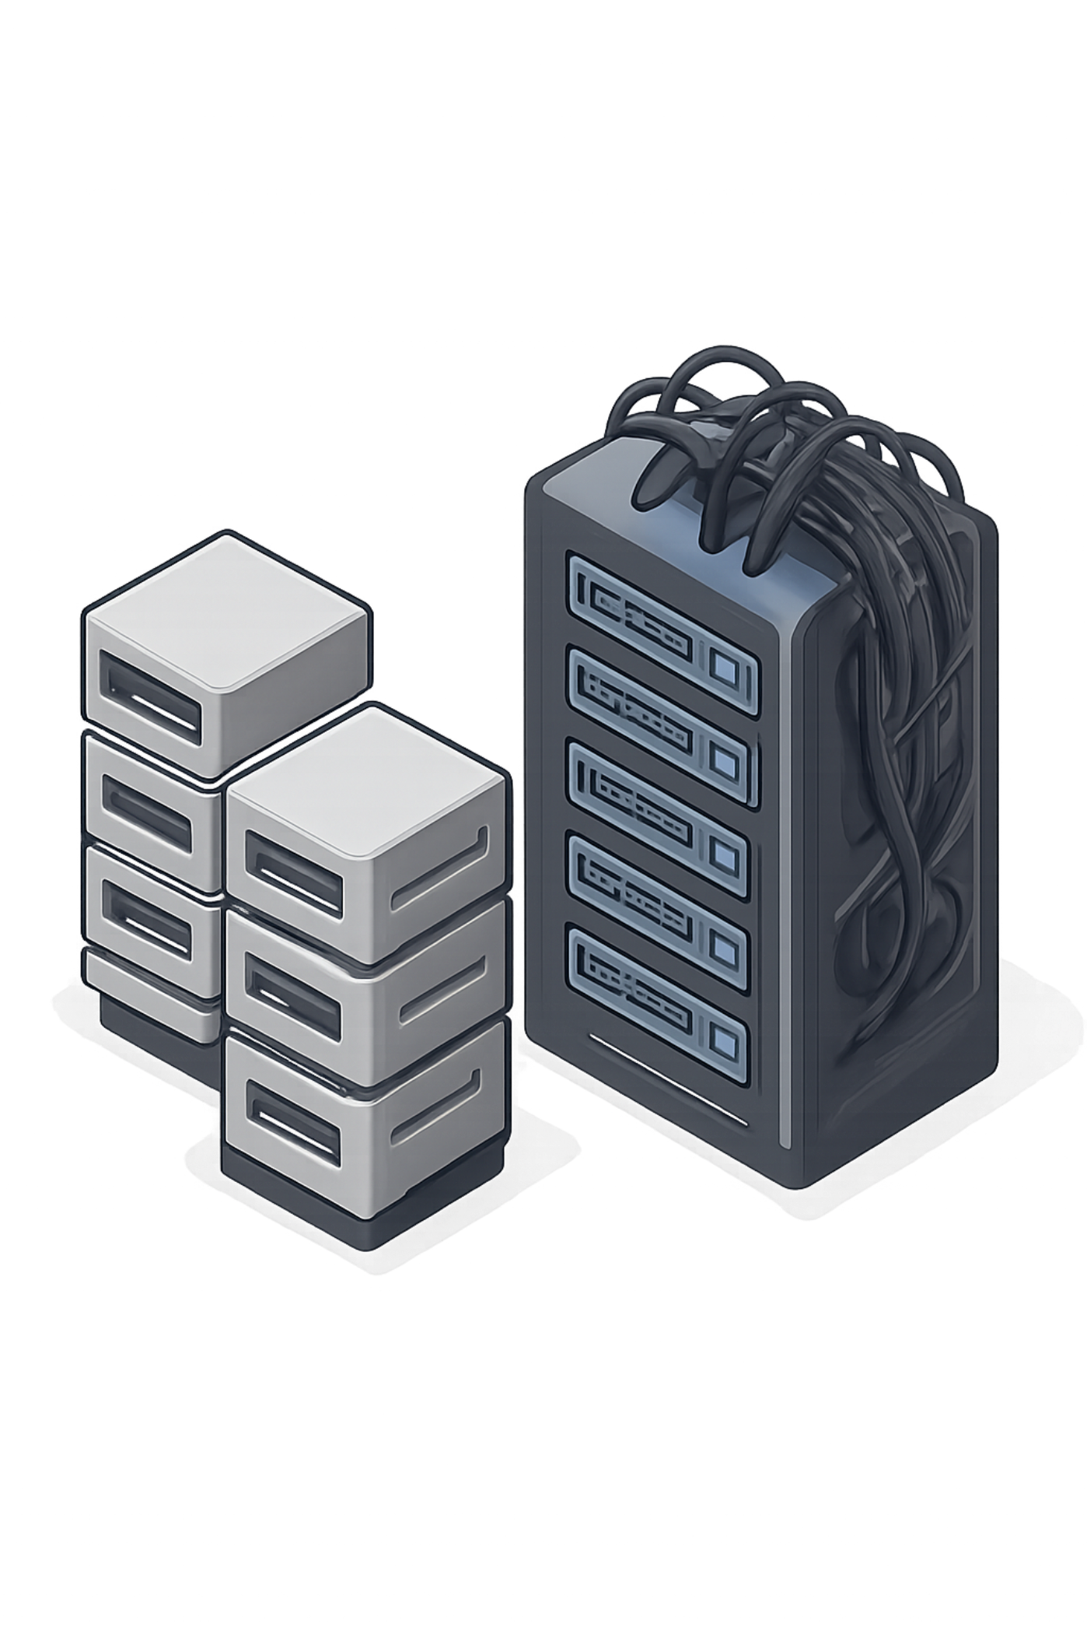
Problem Statement
High energy consumption across cloud datacentres.
Poor and static VM allocation leading to resource wastage.
Uneven host utilisation — some hosts overloaded, others idle.
No intelligent real-time monitoring to trigger corrective actions.
Lack of optimisation that balances SLAs and energy goals.
Current systems use heuristic or manual policies — they need AI-enabled, energy-aware placement and continuous monitoring to improve efficiency.

Slide 4
Project Objectives
Intelligent VM Placement
Energy-aware Scheduling
Real-time Monitoring
Automated placement decisions using host scoring and AI.
Minimise power use while meeting performance targets.
Live dashboards for hosts, VMs and cloudlets.
AI-based Optimization
Resource Utilisation Analysis
SLA Improvement
Adaptive models for placement, migration and consolidation.
Host ranking, utilisation trends and CSV exports for research.
Balance QoS with energy reduction using SLA-aware heuristics.
Future-ready Architecture
Modular design for extension to containers and multi-datacentre.

Slide 5
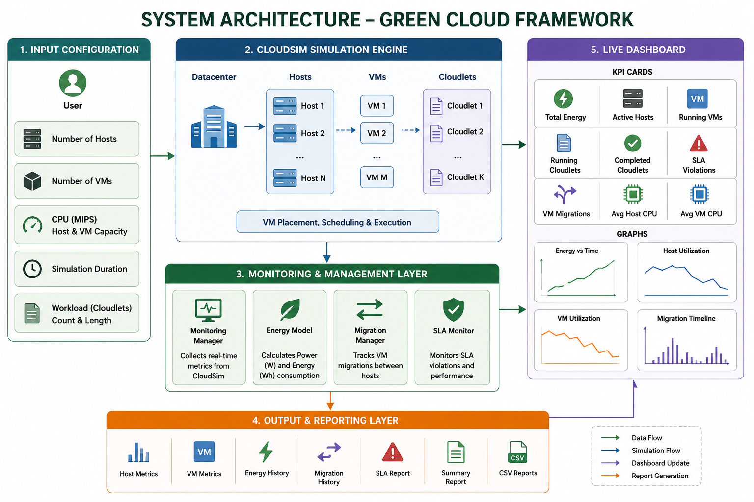

Slide 6
Module 1 — Cloud Simulation Core
Datacenter & Host Creation
VM & Cloudlet Construction
Resource Validation
Define host hardware, power models and network topology.
Instantiate VM profiles and workload (cloudlets) for experiments.
Pre-simulation checks for resource capacities and constraints.
Simulation Execution & Event Logger
CSV Report Generator
Time-ordered events, logs and performance traces for analysis.
Export metrics (utilisation, energy, migrations) for post-processing.

Slide 7

Module 2 — Real-Time Monitoring System
A dashboard-style monitoring console providing continuous visibility into host, VM and cloudlet behaviour with time-series charts and alerts.
Live Monitoring Console & Resource Snapshots
Host / VM / Cloudlet Monitoring (CPU, RAM, Bandwidth, Storage)
Event Timeline & Historical Metrics
Exportable CSV snapshots for analysis and reproducibility

Slide 8

AI-Based Resource Optimization
Energy Analysis
AI VM Placement
Optimization Engine
Migration Engine
Part 1 — Energy Analysis
Part 2 — AI VM Placement
Part 3 — Migration Engine
Part 4 — Optimization Engine
Energy calculator, host power models and host ranking for baseline consumption.
Host scoring engine, placement decision module and historical placement logs.
Migration recommendations, consolidation policies and load balancing strategies.
SLA monitoring, host power management, optimisation scoring and energy-saving analysis.

Slide 9








Technologies Used
Java 17
CloudSim Plus 8.5
Maven
IntelliJ IDEA
SLF4J & Logback
CSV Export
OOP & AI
Cloud Computing

Slide 10
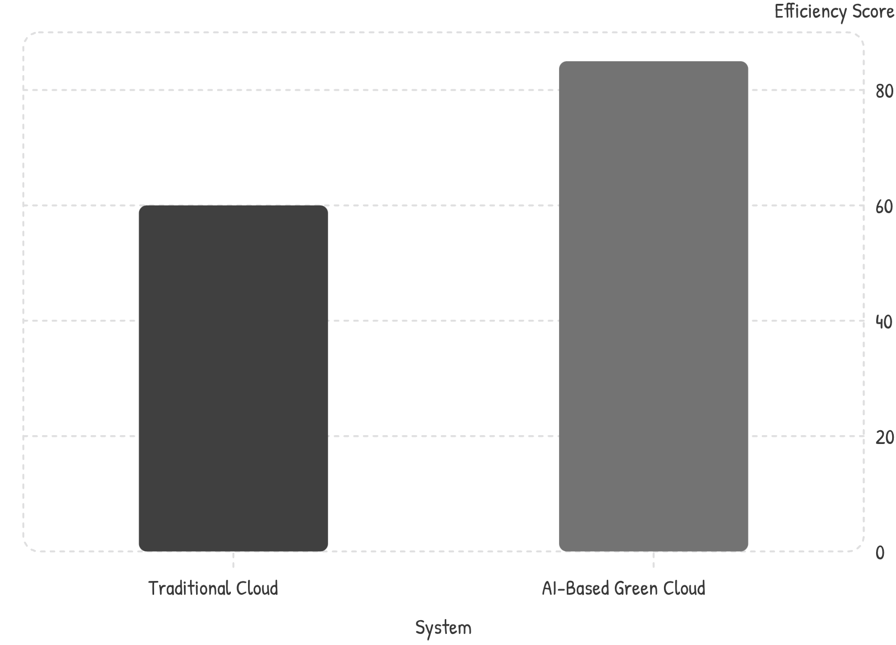
Results
✔ Live Monitoring Console
✔ AI Placement Engine
✔ Energy Monitoring
✔ Migration Recommendations
✔ CSV Export & Event Logging
✔ Modular Architecture & Reports
Comparison chart: AI-based Green Cloud shows measurable improvements in overall efficiency (host utilisation, fewer migrations, and lower energy).

Slide 11

Future Scope
Machine learning prediction for workload patterns.
Reinforcement Learning scheduler for adaptive policies.
Multi-datacentre and renewable-energy aware scheduling.
Container orchestration (Docker / Kubernetes) integration.
Real-time web dashboard with live graphs and alerts.
IoT and digital twin integration for energy-aware edge-cloud.
Sustainable · Intelligent · Extensible

Slide 12

Literature-review
S.No | Paper / Research | Year | Approach | Main Contribution | Limitation / Gap
1 | Modeling the Green Cloud Continuum: Integrating Energy Considerations into Cloud–Edge Models | 2024 | Green Cloud / Cloud-Edge | Integrates energy considerations into cloud-edge models. | No integrated live monitoring dashboard.
2 | Cost and Energy Aware Migration Through Dependency Analysis of VM Components in Virtual Cloud Infrastructure | 2024 | Energy-aware migration | Considers energy, cost and VM dependencies during migration. | Mainly focuses on migration strategy.
3 | Energy-efficient Cloud Systems: Virtual Machine Consolidation with Γ-Robustness Optimization | 2025 | VM consolidation | Improves resource utilization and energy efficiency. | Focuses mainly on optimization.
4 | Towards Dynamic Virtual Machine Placement Based on Safety Parameters and Resource Utilization Fluctuation for Energy Savings and QoS Improvement | 2025 | Dynamic VM placement + CloudSim | Reduces energy, migrations and SLA violations. | Focuses on a specific placement algorithm.
5 | Quality of Service Driven Energy-efficient Computing to Enhance Sustainable Cloud | 2026 | Optimization + CloudSim | Optimizes VM placement for energy and QoS. | Mainly focuses on optimization, not end-to-end monitoring.

Slide 13
References
Amahrouch, A., Saadi, Y., & El Kafhali, S. (2025). Optimizing energy efficiency in cloud data centers: A reinforcement learning-based virtual machine placement strategy. Network, 5(2). https://doi.org/10.3390/network5020017
Rasoulpour Shabestari, E., & Shameli-Sendi, A. (2025). An intelligent VM placement method for minimizing energy cost and carbon emission in distributed cloud data centers. Journal of Grid Computing, 23, Article 12. https://doi.org/10.1007/s10723-025-09798-2
Andreoli, R., Zhao, J., Cucinotta, T., & Buyya, R. (2024). CloudSim 7G: An integrated toolkit for modeling and simulation of future generation cloud computing environments. arXiv. https://doi.org/10.48550/arXiv.2408.13386
Panggabean, C., Verma C., D., Gogoi, B., Limbu, R., & Sarker, R. (2025). Optimized cloud resource allocation using genetic algorithms for energy efficiency and QoS assurance. arXiv. https://doi.org/10.48550/arXiv.2504.17675
Baydoun, A. M., & Zekri, A. S. (2025). Towards efficient VM placement: A two-stage ACO-PSO approach for green cloud infrastructure. arXiv. https://doi.org/10.48550/arXiv.2510.00541
Semwal, A. (2026). Optimizing cloud energy use with artificial intelligence and machine learning. Cureus Journals. https://www.cureusjournals.com/articles/9383-optimizing-cloud-energy-use-with-artificial-intelligence-and-machine-learning

